Slide 1
Lectures 26-28 Ethical Human Conduct
Module 5 – Implications of the Holistic Understanding – a Look at Professional Ethics

Slide 2
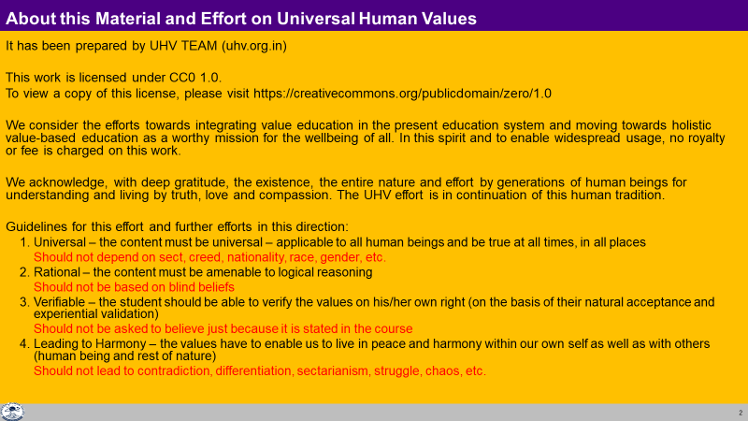

Slide 3
Module 5 – Implications of the Holistic Understanding – a Look at Professional Ethics
(6 lectures and 3 tutorials/ practice sessions)
Lecture 23: Natural Acceptance of Human Values
Lecture 24: Definitiveness of (Ethical) Human Conduct
Tutorial 12: Practice Session PS12 Exploring Ethical Human Conduct
Lecture 25: A Basis for Humanistic Education, Humanistic Constitution and Universal Human Order
Lecture 26: Competence in Professional Ethics
Tutorial 13: Practice Session PS13 Exploring Humanistic Models in Education
Lecture 27: Holistic Technologies, Production Systems and Management Models-Typical Case Studies
Lecture 28: Strategies for Transition towards Value-based Life and Profession
Tutorial 14: Practice Session PS14 Exploring Steps of Transition towards Universal Human Order
It may be pertinent to mention that this course also presents a rather ‘unconventional’, but more fundamental approach to professional ethics where the major focus is on the development of the ethical competence of the individual rather than relying only on codes of conduct, oaths, whistle-blowing etc.

Slide 4
Recalling: Holistic Value-based Education
Human education-sanskar (मानवीय शिक्षा-संस्कार)
Humane world vision
(मानवीय दृष्टि)
Human values (participation in larger order)
मानवीय मूल्य (व्यवस्था में भागीदारी)
Skills for living with human conduct
(मानवीय आचरण पूर्वक जीने के लिए हुनर)
People competent to contribute to a human society, culture, civilisation
Human society,
human culture, civilisation
(मानवीय समाज व व्यवस्था,
मानवीय संस्कृति, सभ्यता)
Universal Human Values (UHV)
Universal
Rational
Verifiable
Leading to Harmony
Case studies of Human Thought, Human Culture, e.g. from IKS
Time tested in education at National level
World-class value guided skills – Education
and practice (nature friendly and human friendly)
An equitable and just society
(village… block… city… district… state… Nation)
National development
(in harmony within and with other nations,
complimentary to other nations)

Slide 5
For more details
UHV-II: Universal Human Values – Understanding Harmony and Ethical Human Conduct
A one-semester 3-credit mandatory course in the AICTE Model Curriculum 2021
Presentations, Handout of Class Notes:
https://fdp-si.aicte-india.org/download.php#1
Recordings on YouTube: Professional Ethics lectures of UHV-II Lectures 23-28 https://www.youtube.com/watch?v=BikdYub6RY0&list=PLWDeKF97v9SPFYVPis99l9eD-wZf0RypK

Slide 6
Lecture 26 Holistic Development towards Humane Society and Tradition

Slide 7
Recap
We saw how right understanding provides the foundation for the identification of universal human values in all the dimensions of life.
It also facilitates the recognition of the definitiveness of ethical human conduct.
Moving on to other important implications of right understanding, in this lecture, we will see how right understanding enables us to visualise holistic development resulting into a humane society (undivided society and universal human order) and humanistic tradition.
We have already explored into how a humane society would be, and we will recall that in brief for our ready reference.

Slide 8
Visualization of Comprehensive Human Goal
An important implication of the right understanding is the visualization of comprehensive human goal which is conducive to human welfare (wellbeing of all).
In the light of the right understanding, it is possible to visualise the pattern of a holistic way of life to ensure the fulfillment of comprehensive human goal, a model of human living which is people-friendly and eco-friendly, therefore, sustainable.

Slide 9
The Vision for Holistic Development and Humane Society
On the basis of the understanding of harmony, we get the notion of a Humane Society- i.e. undivided society and universal human order.
The universal human order will involve:
A holistic pattern in all the dimensions of human activity in the society including education, health-self-regulation, production-work, justice-preservation, exchange-storage, etc.
Harmonious networking between the basic unit and their clusters successively moving from family order to world family order as follows:
Family Order ⇒ … ⇒ Village Order ⇒ Village Cluster Order ⇒ … ⇒ Nation Order… ⇒ World Family Order
In each of these dimensions, we can visualise a humane system, be it education, health, production, exchange or justice and conceptualise a harmoniously functioning overall system.

Slide 10
Harmony in Society – Universal Human Order
Human Goal
Systems / Dimensions of Human Order
1. Education – Sanskar - f”k{kk laLdkj
2. Health – Self-regulation - LokLF; la;e
3. Production – Work - mRiknu dk;Z
4. Justice – Preservation - U;k; lqj{kk
5. Exchange – Storage - fofue; dks’k
Scope –From Family Order to World Family Order (Universal Human Order)
Family – Family cluster – Village – Village cluster ... Nation ... World Family
Order Order Order Order Order Order
~10¹ ~10² ~10¹⁰
Right Understanding & Right Feeling
Prosperity
Fearlessness
(Trust)
Co-Existence
(mutual fulfilment)
Happiness
In Every Individual
In Every Family
In Society
In Nature/ Existence

Slide 11
Paving the Way towards a Humanistic Tradition
The primary step to move towards the holistic way of life is to develop the right understanding among the human beings, commitment to live accordingly and then to develop the requisite skills and knowledge systems to implement the right understanding in real life. Thus, it calls for a change in the education system towards humanistic education. The right understanding provides us with the vision of such a humanistic education.
The humanistic tradition can be visualised in terms of the following four aspects of a humane society-
Humanistic Education
Human Conduct
Human Constitution
Universal Human Order

Slide 12
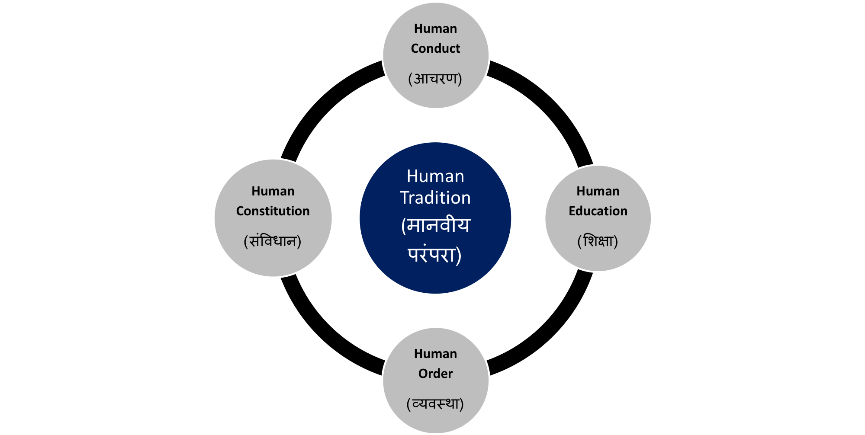

Human Tradition (in which Human Goal is fulfilled generation to generation)
Conduct that ensures
continuity of mutual
happiness &
prosperity
Education that
ensures the
development of the
competence to live
with
Definite
Human
Conduct
Nature of
society
of people living
together in a
relationship of
mutual fulfillment
Entry Point
The society in which
Human Goal
is realised

Slide 13
Human education, constitution…
We have already defined these in module 1-4; however, we are recalling the essense of these for ready reference:
Human education- Education that ensures the development of the competence to live with Definite Human Conduct through right understanding and right feelings.
Human conduct- Conduct that ensures continuity of mutual happiness & prosperity through living with right understanding ad right feelings.
Human constitution- Nature of society of people living together with human conduct i.e. in a relationship of mutual fulfillment
Universal human order-The society in which Human Goal is realised through different dimension of human systems
Humanistic tradition- Continuity of humane society generation after generation- in a self-sustaining manner.

Slide 14
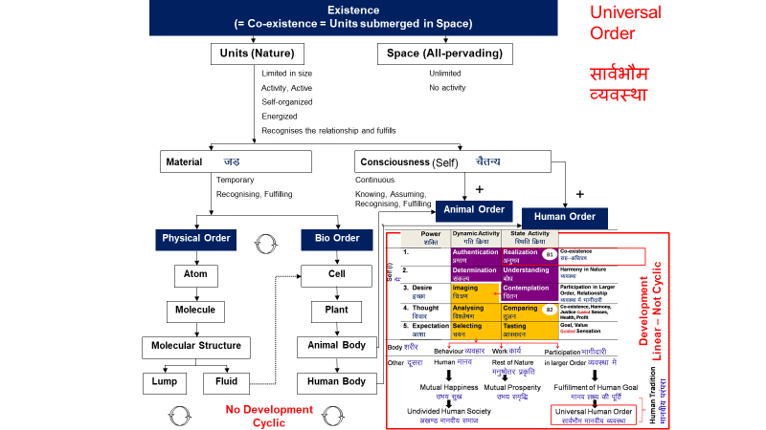
Humane society and Human tradition- a natural process
Important thing to note here is that-
This humane society and human tradition is something which is a natural outcome of the existential harmony (order) already existing and unfolding itself through a natural process, and this process is to be completed through human being.
To meaningfully participate in this natural process, human being has to understand this existential harmony (order) and live in accordance with it.
It is not just a human construct, though, it is articulated and expressed by human being in different ways.

Slide 15
Key Takeaways
Humanistic education leads to human conduct, human constitution, universal human order and in turn, universal human order ensures humanistic education for the next generation.
The entry point in setting the wheel of humanistic tradition rolling, is humanistic education.
Important thing to note here is that-
This humane society and human tradition is something which is a natural outcome of the existential harmony (order) already existing and unfolding itself through a natural process, and this process is to be completed through human being.
To meaningfully participate in this natural process, human being has to understand this existential harmony (order) and live in accordance with it.
It is not just a human construct, though, it is articulated and expressed by human being in their own way

Slide 16
Competence in Professional Ethics
Guidelines for how to interact with various levels of realities through the profession, which is making effort for fulfilment of some part of the human goal
Entity (realities) Competence for
Human beings Behaviour – mutual fulfilment
Rest of nature Work – mutual prosperity
Maintenance, etc. Service (seva)* – promotion of harmony
Societal systems Participation in larger order – promotion of harmony
*service which promotes harmony in family, society at all levels

Slide 17
Lecture 27 Holistic Technologies, Production Systems and Management Models-Typical Case Studies

Slide 18
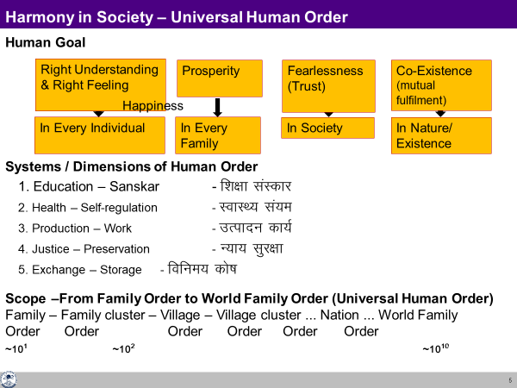
Recap
As discussed in the previous lectures, the right understanding provides us the vision for a holistic development and humane society (universal human order).
Such a model will necessitate the visualization and development of appropriate technologies, production systems and management models etc. which cater to the fulfilment of such a vision.
We will discuss some of the details in this lecture.

Slide 19
Need for a Holistic Worldview
In the present times, there is a great zeal for the development and adoption of innovative technologies and systems, tools, techniques and models which are claimed for the ‘betterment’ of society.
More and more sophistication and complexity are being added. However, most of the effort is going on under the influence of the dominant world view (limited to materialistic perception); needless to say that the holistic world-view is missing in such efforts.
As a result, both the structure as well as the use/misuse of these innovations, is often proving to be counterproductive, contrary to the long-term human welfare.
Therefore, there is a strong need to develop technologies and systems with holistic objectives governed by right understanding to render them conducive to sustainable human welfare (through humane society).

Slide 20
A Holistic Criteria for Evaluation
Catering to appropriate needs and lifestyles
Eco-friendly (cyclic / renewable and mutually enriching)
People-friendly- ensuring self-development and mutual fulfillment in human beings
User-friendly – safe, economical and enhancing human capability
In addition, these have to promote local self-sufficiency and optimal utilization of local resources and expertise.
As far as possible, priority should be for naturally available processes and systems.
In the light of these broad criteria, specific criteria for Evaluation can be broadly defined for the area of technologies, production systems and management models as follows;

Slide 21
Criteria for Technologies
Catering to real human needs (of both the body and the self)
Compatible with natural systems and cycles
Facilitating effective utilization of human body, animals, plants and other natural materials
Safe, user-friendly and conducive to health
Low cost and energy efficient
Producible with local resources and expertise as far as possible
Promoting the use of renewable energy resources
Enhancing human interaction and cooperation
Promoting decentralisation
Enhanced Durability, life cycle and recyclability of products

Slide 22
Criteria for Production Systems
In determining the type of production systems, the key questions to be answered are:
What to produce?
How to produce?
For whom to produce?
How much to produce?
These questions (issues) have been discussed while studying about the harmony in society- human goal and its fulfillment through different dimensions of the societal system.
So, the needs are to be characterised in consonance with the comprehensive human goal and they have to be fulfilled through human systems defined there.
All these will be decided in the context of availability of local natural resources and expertise to cater to the needs of the people for any given community.

Slide 23
Specific Criteria Production Systems
Optimal and efficient utilization of local resources and expertise, including human beings, animals, air, solar, land, water, other bio and mineral resources etc.
Economic viability and sustainability
Priority for local consumption
Matching the pattern of production with the availability/ producibility in the local environment and the pattern of consumption
Decentralized systems capable of meaningful employment of people in the community
Facilitating production by masses and not mass production in a centralized mode, to the extent possible
Promoting individual creativity and sense of accomplishment
Using people-friendly and eco-friendly technologies
Ensuring requisite quality and quantity of production
Harnessing recycling, conservation and reuse possibilities
Safe and conducive to the health of persons involved in production as well as others. Ultimately it should be conducive for self-development.

Slide 24
Criteria for Management Models
Primarily management models are to be relationship based, cooperative and ensuring justice in terms of mutual fulfillment and not coercive and exploitative. Specifically,
The whole unit working as a well-knit family
Cooperative, motivational and mutually fulfilling
Ensuring correct appraisal of human labour and skills
Targeting employer-employee satisfaction as well as consumer satisfaction and not profit maximization
Sharing of responsibility and participative mode of management
Continuous value addition (self-evolution) of the persons involved
Effectively integrating individual competencies and complementarity

Slide 25
A Critical Appraisal of the Prevailing Systems
Present-day systems have been largely developed under the influence of the dominant world view (limited to materialistic perception)
This has caused menace of resource depletion on one hand and environmental degradation manifesting in the form of pollution and global warming etc. on the other.
The other undesirable characteristics of modern technologies and systems include their centralized configurations, promotion of wastefulness, excessive transportation and substitution of human, animal and other natural resources by man-made gadgets, machines and materials (largely dependent on non-renewable enrgy sources)
It has given a lower priority (no priority) to human development and human fulfillment as far as human consciousness is concerned.

Slide 26
Learning from the Systems in Nature and Traditional Practices
To gain an insight into the holistic systems, we have a lot to learn from systems of nature and from traditional practices. Typically,
The water harvesting and storage and utilization systems through ponds and other artifacts
Traditional agricultural practices
Grain storage and food preservation practices
Systems of sharing food and shelter prevalent in social and religious institutions, e.g. langar
Traditional local remedies and health-care techniques
Yoga, Ayurveda, Naturopathy-based and other traditional healthcare systems
Family based rural enterprises
The jajmani system – relationship-based village system to ensure rural self-sufficiency
Rural craft and artisanal practices

Slide 27
Visualizing a Holistic Community Model – Working Towards it Harmony at All Levels
It is high time that we start working for actualization of the model of human order at the village level (a Holistic Community Model – gram-swarajya) in the light of right understanding.
Several groups of people have started working in this direction seriously.
As a result, many technologies and systems have been evolved even though the full-scale demonstration of such alternative ways of living is yet to emerge.
There needs to be an increasing and wide spread thrust to evolve holistic technologies and systems through dedicated R&D efforts working within the framework of right understanding
We will present some details about such a Holistic Community Model– each one of us can try to work out the further details and come up with a working model.

Slide 28
Some Topics for Case Studies
Renewable and Decentralized Energy Technologies (a) Biomass based Energy Conversion systems (b) Gadgets and Implements to facilitate efficient utilization of human muscle power and animal draught power (c) Decentralized Wind power (d) Micro hydel electro-mechanical power generation etc.
Systems for water conservation and water shed management for efficient utilization of rain water and for eco-restoration.
Technologies and architecture promoting green building materials and energy conservation
Organic/natural farming techniques
Eco-sanitation techniques for small scale decentralized sewage disposal and waste water recycling
Low cost and energy efficient technologies for small scale production systems
Humanistic organizational/management models

Slide 29
Key Takeaways
Based on right understanding, the guidelines, criteria, examples and case studies about Holistic Technologies, Production Systems and Management Models can be worked out.
We can also learn from the systems in nature and the traditional practices to evolve a holistic model of living ensuring harmony at all levels.

Slide 30
Lecture 28 Strategies for Transition towards Value-based Life and Profession

Slide 31
Recap
At this concluding stage, it is appropriate to recapitulate the core message of this course and then to visualise the steps that each one of us can take for transition from our present state towards a holistic, fulfilling way of life towards universal human order.

Slide 32
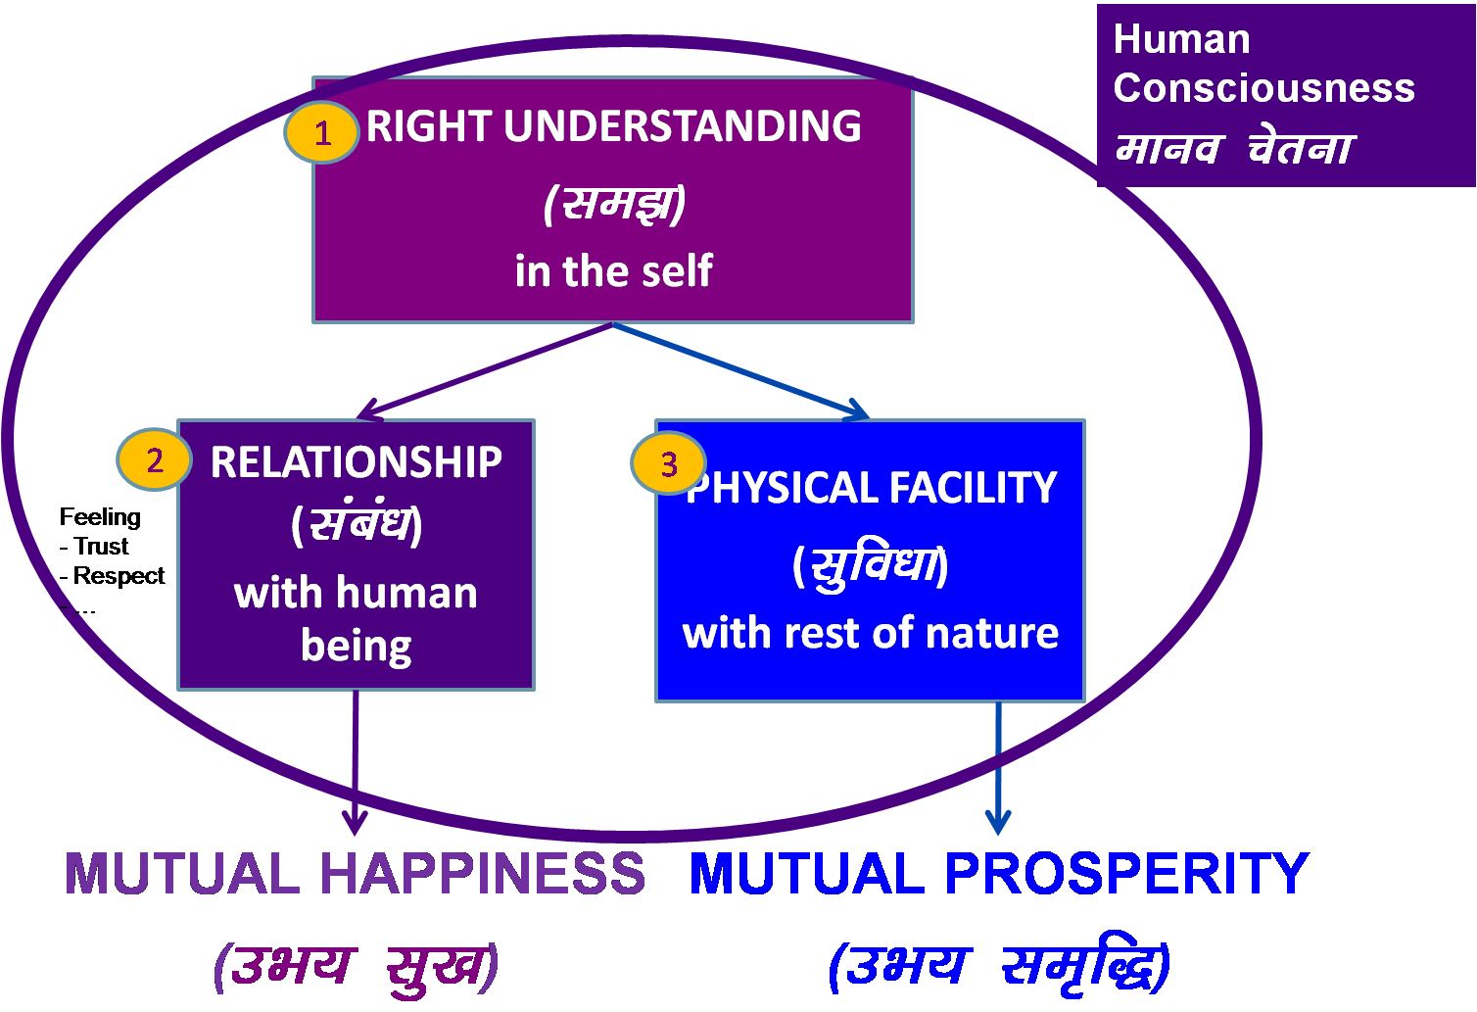
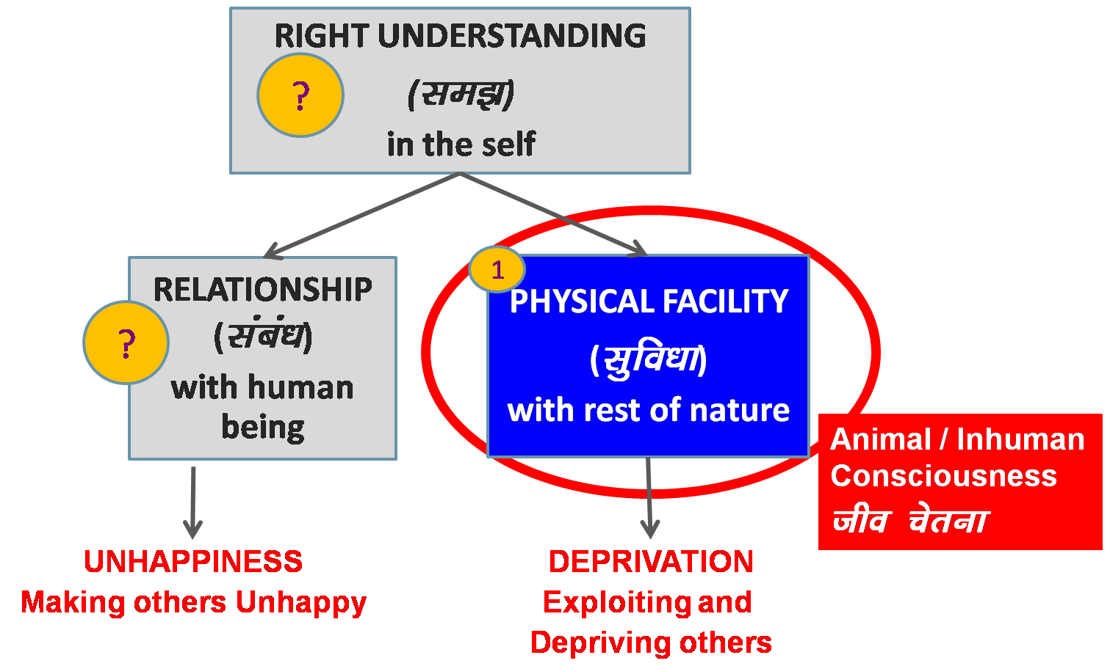
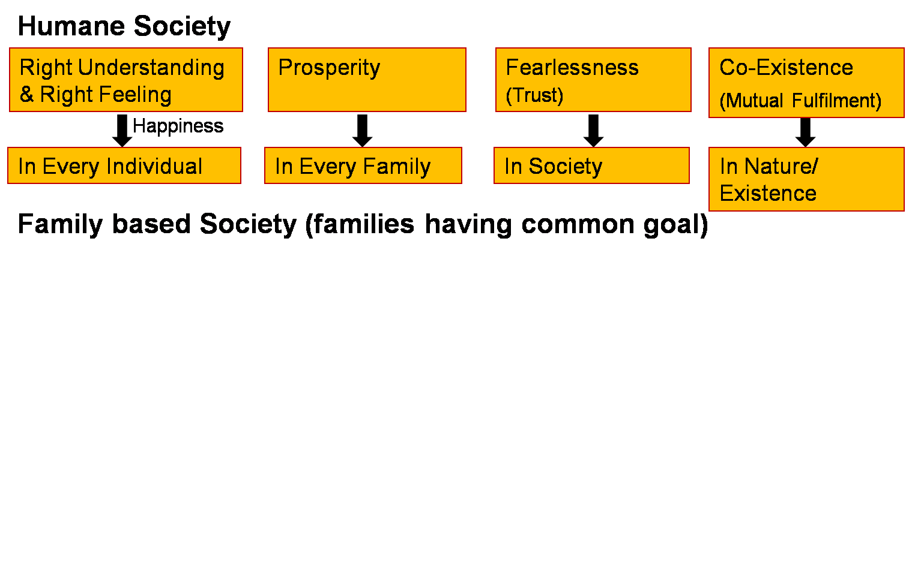
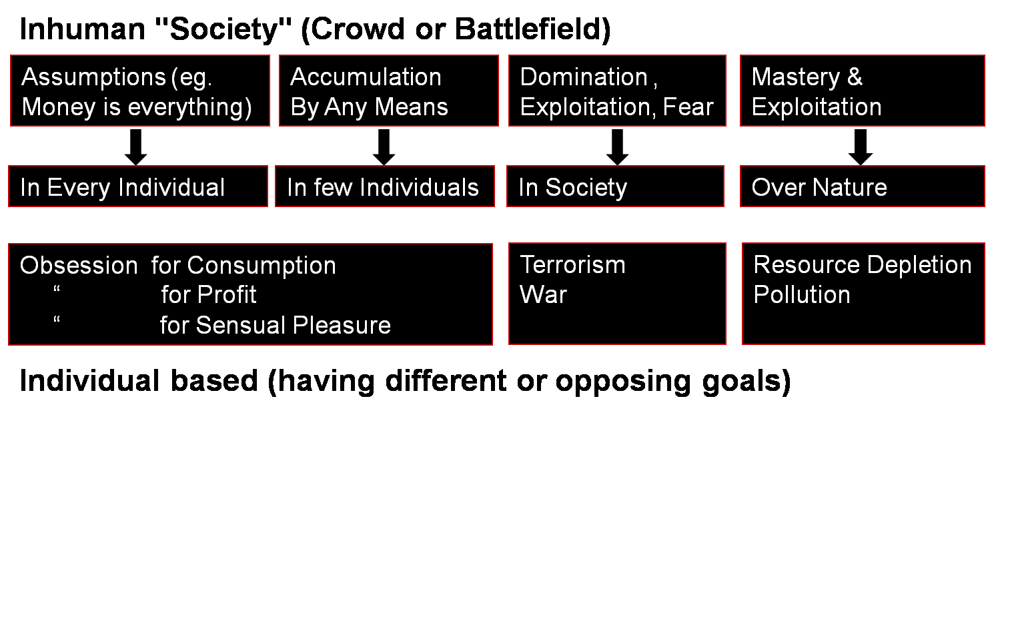
Transformation& Progress
laØe.k&fodkl
Overall Transformation
In the individual
In the society

Slide 33
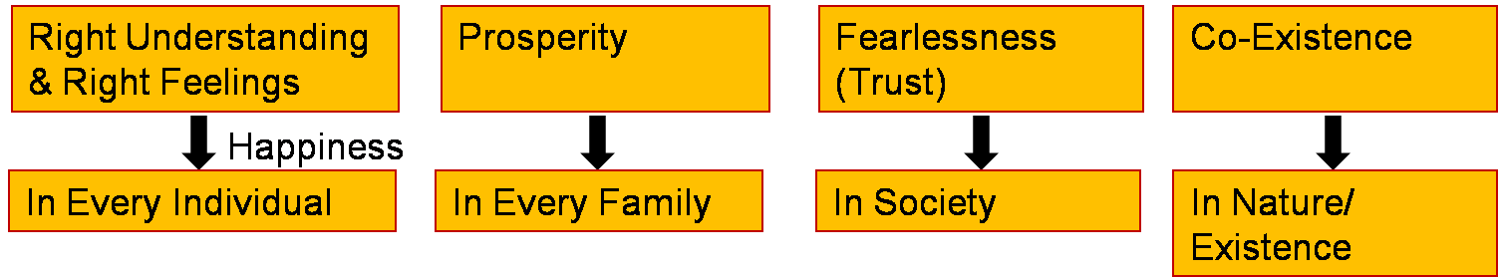
Steps Toward Universal Human Order
People’s Education Program (yksd f'k{kk ;kstuk): for adults
Education-Sanskar Program (f'k{kk laLdkj ;kstuk): for children
Undivided Society, Universal Human Order Program
(v[k.M lekt] lkoZHkkSe O;oLFkk ;kstuk)
Just as a seed replicates itself, so the vision of an Undivided Society and Universal Human Order can be evidenced on this planet…
Family – Family cluster – Village – Village cluster ... Nation ... World Family
~10¹ ~10² ~10¹⁰
10 yrs 1
Next 10 yrs 10
100 yrs 1000 cr
People with Right Understanding & Right Feeling
Parents - Policy Makers
Teachers …
20-50 yrs
People with Right Understanding & Right Feeling
- People with definite Human conduct, the competence to participate in Universal Human Order
10-20 yrs
Fulfilment of Human Goal

Slide 34
The Core Message
To be able to fulfil the basic human aspirations i.e., happiness and prosperity and their continuity, it is essential to gain the right understanding – the understanding about oneself vis-a-vis the rest of existence, the understanding about continuous happiness and prosperity.
This involves the realization that there is an innate harmony at all levels of existence. In fact, the whole existence is co-existence.
It is the essential purpose of human beings to understand this harmony and co-existence and learn to live in accordance with it and be fulfilled.
It thus leads to:
Individual transformation – from animal consciousness to human consciousness and
Societal transformation – from inhuman society to humane society

Slide 35
Steps for Transformation
Step 1: Steps for Individual Transformation
Step 2: Creating Mass Awareness towards Holistic Development
Step 3: Moving towards Humanising the Mainstream Education
Step 4: Developing Models for Holistic Living in Educational Institutions and
in the Community

Slide 36
Step 1: Steps for Individual Transformation
1.1 To verify the proposals on your own right, i.e. on the basis of your natural acceptance and on the basis of your experiential validation.
1.2 To be aware of yourself, of your imagination (desire, thought and expectation) every moment. With this awareness, you will know the content of your imagination and also of all the accumulated acceptances which are your sanskar.
1.3 Now, with the awareness of your imagination, of your sanskar, the third sub-step is self-evaluation – to evaluate your sanskar vis-à-vis your natural ac
Recall that
sanskar (t) + environment (t) +self-exploration (t) →sanskar (t+1)

Slide 37
Step 2: Creating Mass Awareness towards Holistic Development
With the right understanding and right feeling in you, you will develop the willingness and capacity to share with others.
Through sharing, you are facilitating and developing other people to have the right understanding, right feeling and right thought.
It can be in the form of informal talks and formal workshops.
The people to share with would include among others:
Family members and friends
People who have interest and readiness for purposeful social effort and social development
Educators, teacher and education administrators
People connected to governance
Your colleagues at work
To start with, it is important to share only with those who are already willing to listen. If you start this step before you have done sufficient work on yourself, people may not be able to accept you as a preceptor

Slide 38
Step 3: Moving towards Humanising the Mainstream Education
3.1 Integrating appropriate inputs of value education at various levels in the current curricula from school education to higher education.
3.2 To effectively proliferate the above effort, requisite support and policy initiatives by monitoring agencies, such as MHRD, UGC, AICTE, ICMR, University Academic Councils and School Education Boards will be helpful.
3.3 Further, it will be essential to introduce teacher orientation programs (faculty development programs) and development of resource material to implement the above suggestions at a large scale.
3.4 The next sub-step will be to provide adequate thrust to R&D dedicated towards transforming the whole mainstream education into humanistic education (value-based education). This is going to be a long-drawn process. However, it is indispensable.

Slide 39
Step 4: Developing Models for Holistic Living in Educational Institutions and in the Community
This will also necessitate linking the educational institutions with local development programs in collaboration with voluntary organizations and government agencies.
Accordingly, the focus of R&D in higher education institutions will need to be shifted towards various aspects of holistic development, resulting in the development of real-life models facilitating universal human order.

Slide 40
Key Steps for Change: Initial Steps in Implementating Holistic Human Education
Step 1: Value Education मूल्य शिक्षा
Incorporating values in existing curriculum
Incorporating case studies of harmonious living: Cases from local Culture, Civilisation, Knowledge System. e.g. Local, regional, Indian culture, civilisation – Indian Knowledge System (IKS)
Incorporating practice in Skill Development
Step 2: Value Based Education मूल्य परक (संस्कार आधारित) शिक्षा
Organising the whole curriculum on the basis of values, for living in harmony
Holistic and Value-Based and Practice Oriented and Integrative Skill Development
Step 3: Value Based Living मूल्य परक जीना (मानवीय संस्कृति पर आधारित)
Practice of living in harmony, harmonious behaviour, work and
participation for harmony – in family, institution, society… nation… world

Slide 41
Key Takeaways
To ensure happiness and prosperity and their continuity for all human beings, the transition to human consciousness and humane society is essential.
This requires a dedicated effort to implement at a mass scale, the humanistic education focusing on right understanding.

Slide 42
Practice Sessions
For Module 5 (Lectures 26-28)

Slide 43
Practice Session after Lecture 26
Tutorial 13: Practice Session PS13 Exploring Humanistic Models in Education
By careful analysis, identify some important features which, when incorporated, will make our education more humanistic. What are the right expectations in terms of the outcome from humanistic education?
Some people feel that talking about holistic development is like trying to turn the wheel of time backwards. It will greatly hamper our progress. What is your view in this regard? Explain with justification.

Slide 44
Expected Outcome
The students are able to detail out various social systems essential for their own fulfilment, as well as the fulfilment of future generations. In particular, they are able to visualise the education system required for individual, and then societal transformation. They are also able to appreciate those many efforts made in the tradition that were in line with desirable human goals. Thus, they are able to learn from tradition and develop a deep sense of gratitude for the effort, for the people, for the tradition, culture etc.

Slide 45
Practice Session after Lecture 28
Tutorial 14: Practice Session PS14
Exploring Steps of Transition towards Universal Human Order
Suggest ways in which you can use your knowledge of Technology/ Engineering/ Management/Medicine etc. for universal human order, from your family order to the world family order.
The course is going to be over now. Evaluate your state before and after the course in terms of a. Thought b. Behaviour c. Work d. Realization
Do you have any plan to participate in the transition for the humane society after graduating from the institute? Write a brief note on it.

Slide 46
Expected Outcome
The students are able to visualise an appropriate utilization of the knowledge in their respective streams to ensure mutually enriching and sustainable systems. They are able to sincerely evaluate the course and the transformation achieved in this process. They are also able to make use of this understanding for moving towards a happy and prosperous life, including an ethical conduct of their profession.

Slide 47
FAQs for Lectures 26-28
Ethics

Slide 48
Questions
Do you think the society can ever turn ethical? We have been talking about ethics for a long time.
...

Slide 49


Slide 50
Self Reflection

Slide 52
FAQ

Slide 53
FAQ
Developing Ethics & Values, Code of Conduct, CSR, Types of emotions, the role of intelligence and emotion influencing intelligence. Universal Human Values, Self, Inter-personal Skills, Cognitive Physiology and Intelligence…

Slide 54
Universal Human Values and Ethics

Slide 55
Professional Ethics – Do’s and Don’ts at the Workplace…
Behaviour Ethical behaviour
Work and Ethical work Professional Ethics
Participation Ethical participation

Slide 56
Human Being in this Existence
There is an innate harmony and orderliness in the existence
The human beings only need to understand it (there is no need to try and create it)
The universal human values are manifestations of the truth of existence, i.e. co-existence, in various dimensions of human participation in the existential order
These values are naturally acceptable to all human beings and conducive to human happiness (an wellbeing of all)
Only our ignorance leads to all the difficulties and confusions in appreciating and inculcating these universal values

Slide 57
Professional Ethics is a Part of Ethical Human Conduct - Larger Picture
Understanding Relationship, Harmony, Co-existence
Feeling of relationship, harmony, co-existence
mutual fulfilment in relationship Universal Human Values
Thought Principles and
Guidelines for
Ethical Human Conduct
Behaviour Ethical behaviour
Work and Ethical work Professional Ethics
Participation Ethical participation
Outcome Continuous happiness at individual level and
expected Fulfilment of human goal at societal level

Slide 58
Universal Human Values – Articulation 1
Truth = understanding co-existence, the innate harmony and orderliness in existence
Love = feeling of co-existence
= the feeling of being related to all, in a mutually fulfilling manner
Compassion = living with a feeling of co-existence
= expression of the feeling of being related to all
= being complimentary in every relationship

Slide 59
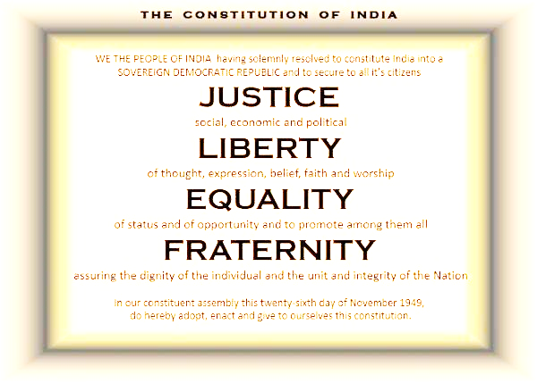
Values espoused in the Constitution of India = Universal Human Values – Articulation 2

Slide 60
Justice
Social, economic and political justice
Harmony in human-human relationship
Recognition of human-human relationship, its fulfilment and right evaluation, leading to mutual happiness (harmony)
Harmony in human-rest-of-nature relationship
Recognition of human-rest-of-nature relationship (natural laws), its fulfilment and right evaluation, leading to mutual prosperity (harmony)

Slide 61
Liberty
of thought, expression, belief, faith and worship
Swatantrata - Living in accordance with one’s innate humanity or natural characteristics leading to harmony in all aspects of living
As an individual human being
As a member of the family
As a member of the society
As an unit in nature/existence

Slide 62
Equality
Of status and of opportunity and to promote among them all
The truth is that
Every human being is similar to me (we have the same goal, the same program and the same potential) and we are complimentary to each other
Every unit in nature is important in its own right. The whole is interrelated, interdependent and every unit is mutually fulfilling for every other unit
When I realise this truth, I have a feeling of Love or Ananyata or Equality
Then, there is compassion in my behaviour with every human being
and
compassion in my work with rest-of-nature

Slide 63
Fraternity
Assuring the dignity of the individual and the unit and integrity of the Nation
I live with responsibility, in harmony in the family, in the society and the entire nature
I live in harmony with human beings leading to mutual happiness
I participate in maintaining the harmony in the social systems
I live in harmony with rest-of-nature leading to mutual prosperity
(my work is human-friendly and nature-friendly)

Slide 64
Sustainable Development Goals = Universal Human Values – Articulation 3
Human Rights - with a balance of human responsibilities
Sustainable Development - cyclic and mutually enriching, just like any process in nature Sustainable Living - living with wisdom, clarity of human purpose and program Global Wellbeing - wellbeing of all – human as well as rest-of-nature

Slide 65
Process of Developing Universal Human Values and Definite, Ethical Human Conduct
Understanding Value Education
(definite, universal, invariant…) (proposals,
Right World-view, Perspective self-exploration,
knowing,
Self-discipline)
Natural Acceptance
Thinking Moral Education
(ideas, morals…) Belief
Doing Discipline, Instructions
(behaviour, work) (externally enforced
fear, incentive…)
Conduct is Indefinite
Conduct is
Indefinite
Human Conduct
(Definite, Ethical)

Slide 66
IQ, EQ, SQ etc.

Slide 67
IQ: Intelligence Quotient
Ability to analyse
To generate multiple solution options and to compare these options on the basis of some criteria
The criteria for comparison is focused on achieving harmony, prosperity, wellbeing of all rather than domination, profit maximisation etc.

Slide 68
EQ: Emotional Quotient
Ability to have the right feeling within (inspite of the external circumstances), to think of solving the problems…

Slide 69
SQ: Social Quotient
Ability to relate to people of all types, to be complimentary in relationship

Slide 70
Developing Universal Human Values and Ethics
Process

Slide 71
Professional Ethics is a Part of Ethical Human Conduct - Larger Picture
Understanding Relationship, Harmony, Co-existence
Feeling of relationship, harmony, co-existence
mutual fulfilment in relationship Universal Human Values
Thought Principles and
Guidelines for
Ethical Human Conduct
Behaviour Ethical behaviour
Work and Ethical work Professional Ethics
Participation Ethical participation
Outcome Continuous happiness at individual level and
expected Fulfilment of human goal at societal level

Slide 72
For more details
UHV-II: Universal Human Values – Understanding Harmony and Ethical Human Conduct
A one-semester 3-credit mandatory course in the AICTE Model Curriculum 2021
Recordings on YouTube: Professional Ethics lectures of UHV-II https://www.youtube.com/watch?v=BikdYub6RY0&list=PLWDeKF97v9SPFYVPis99l9eD-wZf0RypK

Slide 73
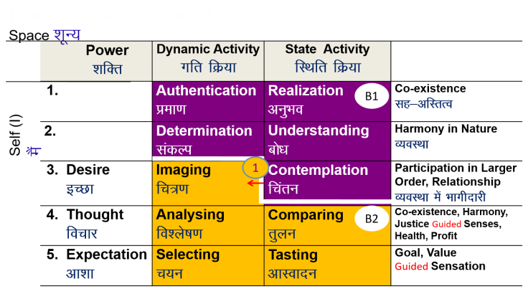
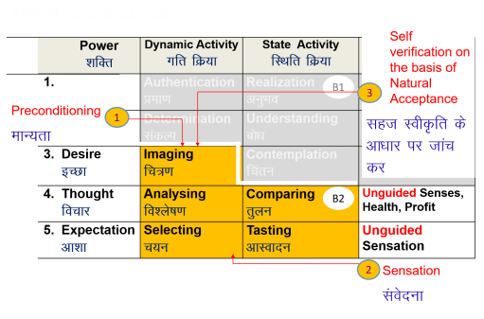
Understanding Harmony
Feeling of relationship
mutual fulfilment
Thought how to be mutually
fulfilling
Behaviour Ethical behaviour
Work and work
Participation participation
Promotion Self discipline, Complementarity
(Human Constitution)
Outcome Mutual happiness
Prosperity in human being
Preservation of rest of nature
Preconditioning Conflict…
Feeling of opposition,
competition…
Thought Mixed,
how to maximise my gains...
Behaviour Indefinite behaviour
Work and work
Participation participation
Promotion Discipline
Fear of punishment
Incentive of reward…
codes of conduct,
oaths, whistle-blowing…
Outcome Mixed
VALUES
POLICY
CHARACTER

